Slide 1



Electric vehicle
View in Power BI
Last data refresh:
17-03-2024 18:44:44 UTC
Downloaded at:
17-03-2024 18:47:27 UTC

Slide 2
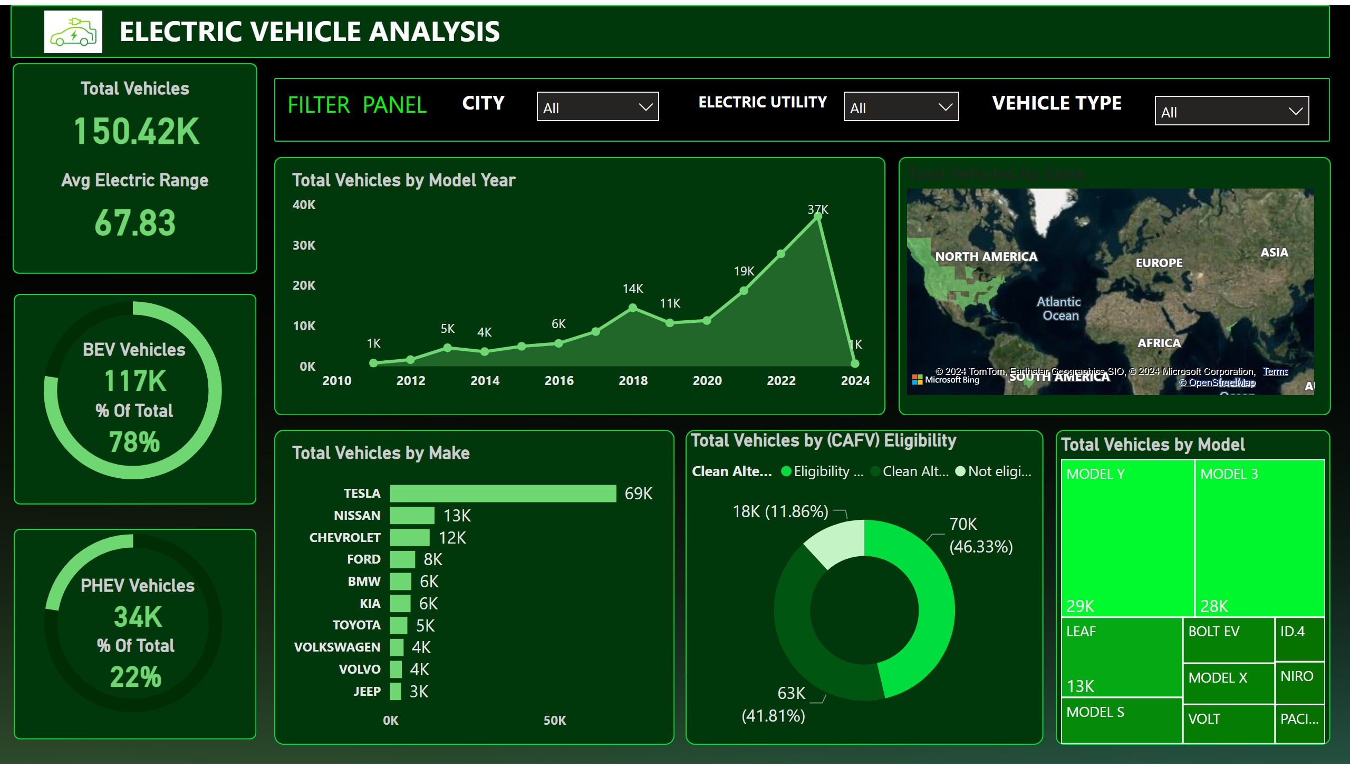
Page 1
Notes:
shape
No alt text provided
textbox
No alt text provided
shape
No alt text provided
Total Vehicles
No alt text provided
Avg Electric Range
No alt text provided
shape
No alt text provided
shape
No alt text provided
donutChart
No alt text provided
BEV Vehicles
No alt text provided
% Of Total
No alt text provided
donutChart
No alt text provided
PHEV Vehicles
No alt text provided
% Of Total
No alt text provided
shape
No alt text provided
shape
No alt text provided
areaChart
No alt text provided
shape
No alt text provided
filledMap
No alt text provided
shape
No alt text provided
barChart
No alt text provided
shape
No alt text provided
Total Vehicles by (CAFV) Eligibility
No alt text provided
shape
No alt text provided
treemap
No alt text provided
textbox
No alt text provided
slicer
No alt text provided
textbox
No alt text provided
slicer
No alt text provided
textbox
No alt text provided
textbox
No alt text provided
slicer
No alt text provided
image
No alt text provided

